Slide 1
KBC GAME

Slide 2

Shri Vaishnav Vidyapeeth Vishwavidyalaya
KBC Quiz Gameplay
Class - B.TECH, Computer Science Engineering
Specialization - ARTIFICIAL INTELLIGENCE
----- Developed By -----
18100BTCSAII02860 Sajal Jain
18100BTCSAII02868 Sparsh Tiwari
18100BTCSAII02859 Rohan Yadav
18100BTCSAII02873 Viral Khatri
18100BTCSAII02852 Pragya Jain
18100BTCSAII02873 Vibhor Joshi

Slide 3
ACKNOWLEDGEMENT
We have taken efforts in this project. However, it would not have been possible without the kind support and help of many individuals. We would like to extend our sincere thanks to all of them.
We are highly indebted to “SHRI VAISHNAV VIDYAPEETH VISHWAVIDYALAYA” for their guidance and constant supervision as well as for providing necessary information regarding the project and also for their support in completing the project.
We would like to express our special thanks of gratitude to our professor “Mr. Gurpreet Singh” who gave us the golden opportunity to do this wonderful project on the topic “QUIZ MANAGEMENT SYSTEM”.
We would like to express our gratitude to our parents and members of our group for their kind cooperation and encouragement which help us in completion of this project.
Our thanks and appreciation also go to the people who are directly or indirectly helped us out in developing the project.

Slide 4
INDEX
Introduction
Features
Scope of Project
Flowchart
Project at Glance
Welcome Screen
Instruction Screen
Main Screen
Main Screen II
Lifelines
Conclusion
Concluded Points
Future scope of Project

Slide 5
INTRODUCTION
The "KBC Quiz System" has been developed to over right the problems prevailing in the practicing manual system. This software is supported to eliminate and in some cases reduce the hardships faced by this existing system. Moreover this system is designed for the particular need of the company to carry out operations in a smooth and effective manner.
The application is reduced as much as possible to avoid errors while entering the data. It also provides error message while entering invalid data. No formal knowledge is needed for the user to use this system. Thus by this all it proves it is user-friendly. KBC Quiz System , as described above, can lead to error free, secure, reliable and fast management system. It can assist the user to concentrate on their other activities rather to concentrate on the record keeping. Thus it will help organization in better utilization of resources.

Slide 6
FEATURES
Have three lifelines for help.
Admin can add or remove the questions as per their need.
User Friendly.
Mouse pointer control available.
Simple Status & Resolutions
Interactive and Entertaining

Slide 7
SCOPE OF PROJECT
In computer system the person has to fill the various forms & number of copies of the forms can be easily generated at a time.
In computer system, it is not necessary to create the manifest but we can directly print it, which saves our time.
To assist the staff in capturing the effort spent on their respective working areas.
To utilize resources in an efficient manner by increasing their productivity through automation.
The system generates types of information that can be used for various purposes.
It satisfy the user requirement.

Slide 8
TECHNOLOGY USED IN PROJECT
FRONTEND LANGUAGE : C++
BACKEND : FILE HANDLING

Slide 9
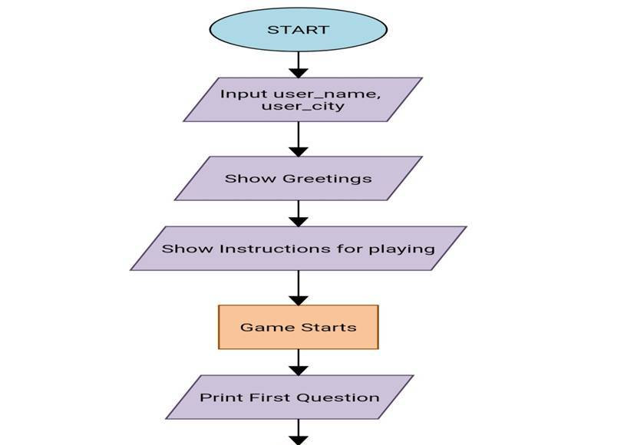
FLOWCHART :

Slide 10
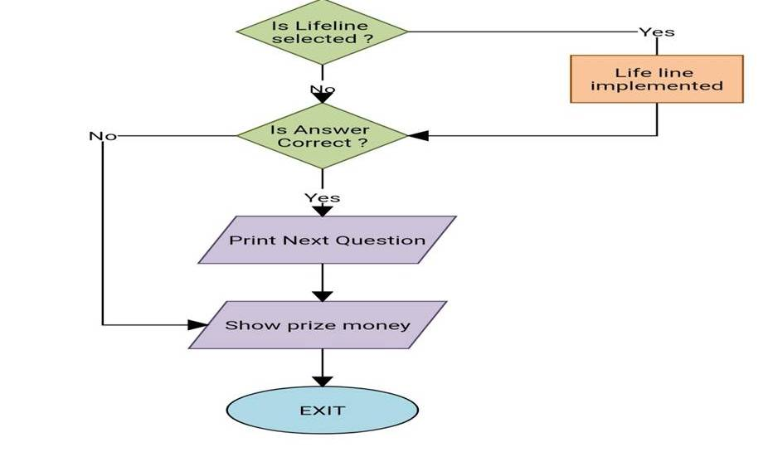

Slide 11
PROJECT AT A GLANCE

Slide 12
FRONT PAGE
This is the opening page of our program which consists of the main logo of our project its title and the presenter’s name. it is basically a fully graphical representation of the c++ programming language , and depicts its graphical usage & implementation on point.

Slide 13


Slide 14
WELCOME SCREEN
This frame is one of the most important frames because this screen provides us the touch of user accessibility of a c++ program. this screen gets the input from the user regarding his/her name and address. later the screen also depicts the rough glance of the actual game.

Slide 15
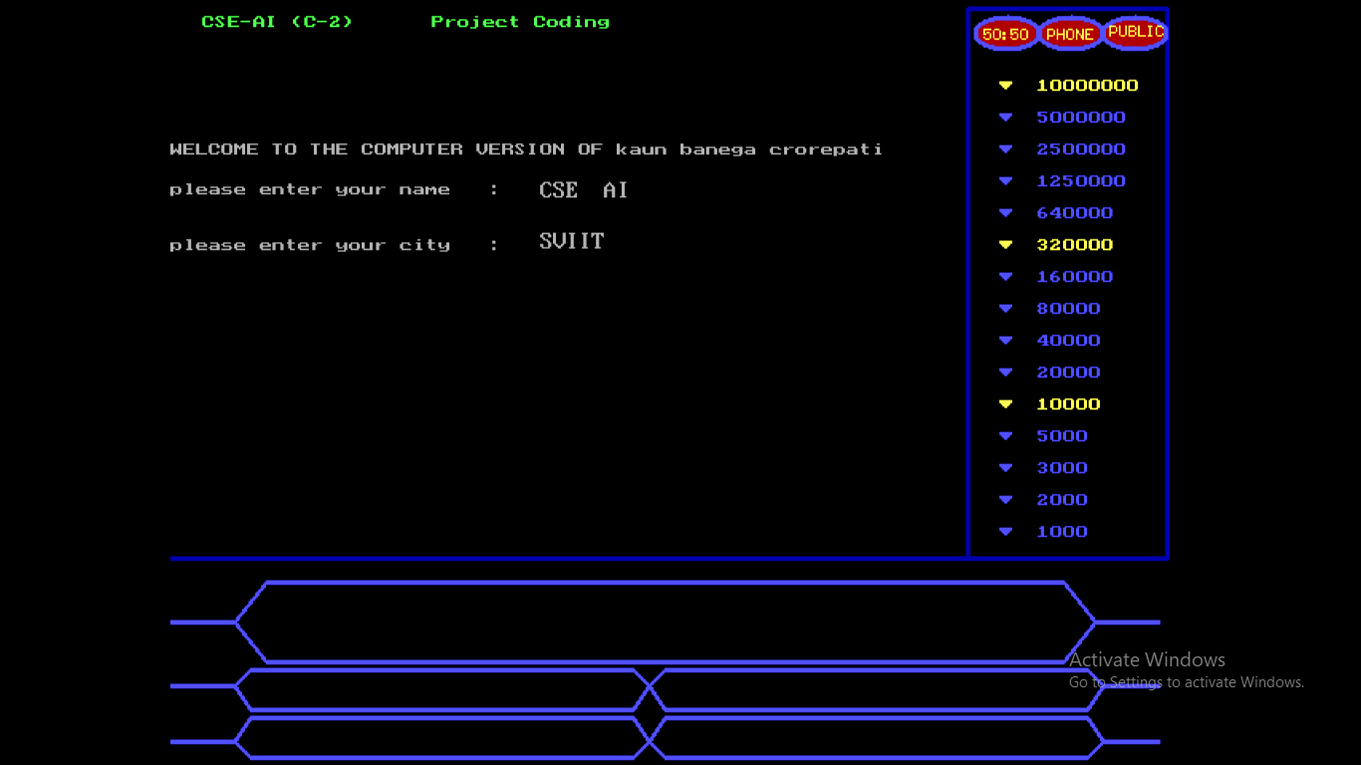

Slide 16
INSTRUCTION SCREEN
This screen is again very important according to the players perspective as it gives them the set of rules to be followed during the gameplay the instructions fall on the screen one by one ,so that the user gets appropriate time to read .

Slide 17
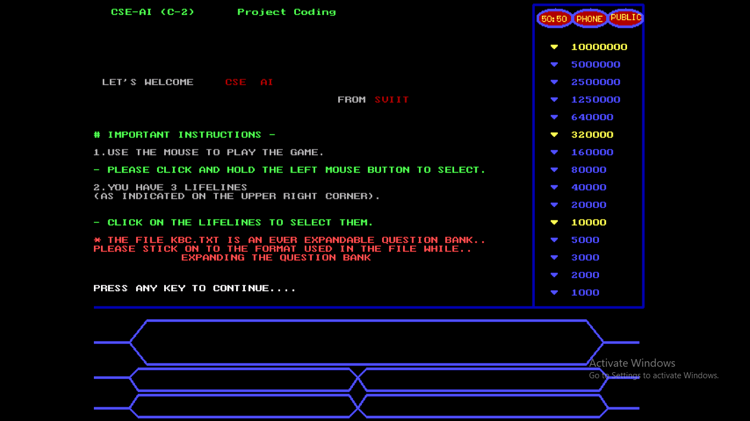

Slide 18
MAIN SCREEN
This screen is the main screen and the actual space where the real gameplay or the actual program implementation is being occurred.
This screen consists of a side table that defines life lines and achievements , also it consists a set of polygons below called the question containing area, it provides the user with questions and its four option out which the user has to choose one correct option to win.

Slide 19
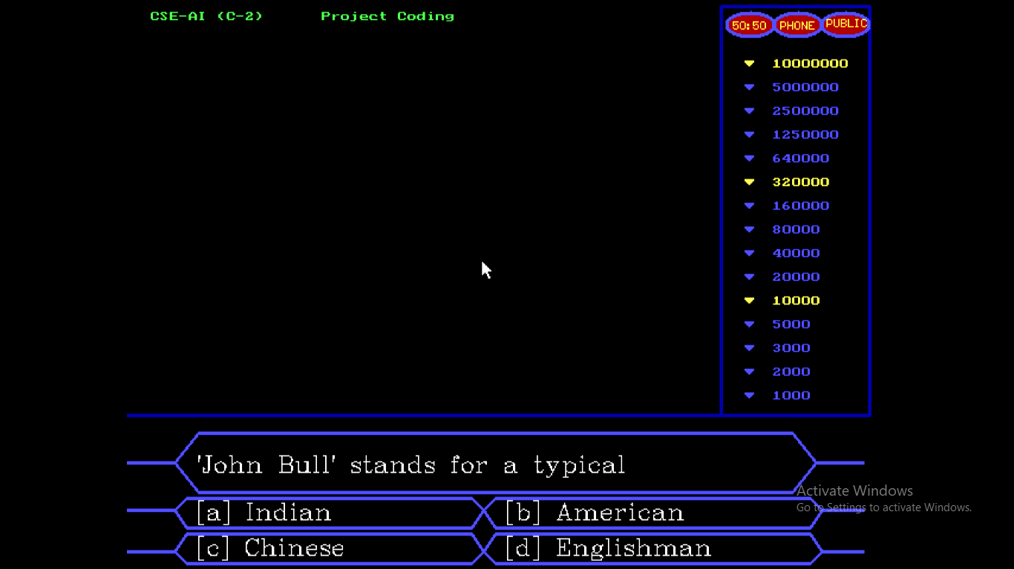

Slide 20
MAIN SCREEN II
This is the part of main screen that shows what are the graphical implementations of c++ used here in the main frame.
The gameplay provides a mouse controlled input procedure which ease the user to access the game , it also contain a side table which always shows a pointer of the achievement money that has been unlocked till now and if u give the correct answer the prize money flashes on the screen.

Slide 21
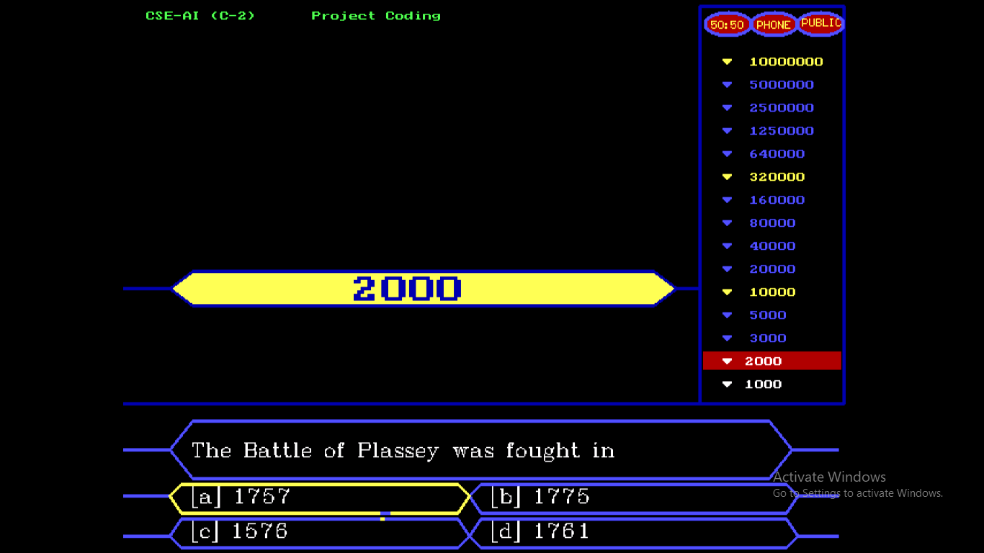

Slide 22
LIFE LINES
The gameplay allows the user some chances to get the correct answers for the question and these chances are known as life lines
it has three life lines:-
A) 50-50 LIFE LINE
This life line eliminates two incorrect options out of the four options so that the user arrives at a lesser risky part to win .

Slide 23
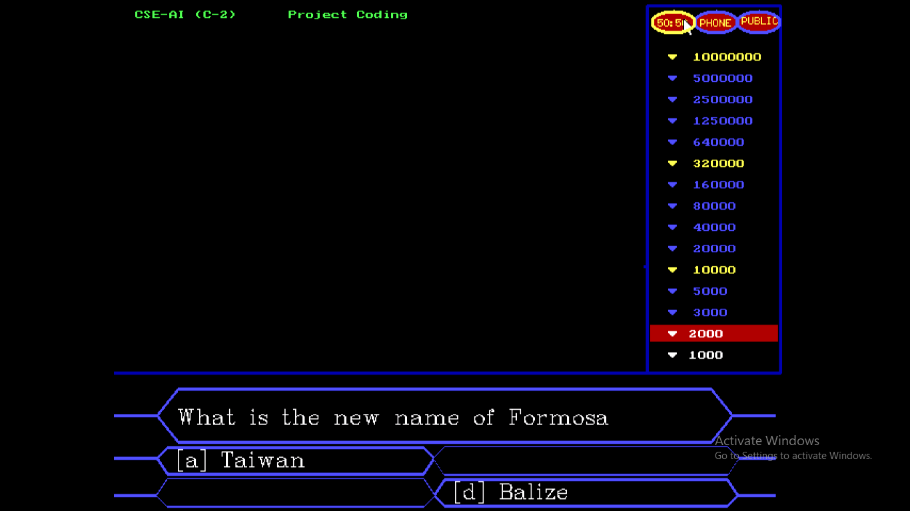

Slide 24
B) AUDIENCE POLL
Audience Poll helps the player to reach the correct option. It is the data obtained by general public opinions, it is completely based on international surveys on mass people. Usually this data helps the user to find the correct answer easily. This lifeline totally depends on public polls i.e. people vote for the correct option out of the given four options as per their knowledge to help the player. The option that gets the most percent of votes is considered to be as the correct answer but is not totally reliable , this is done to give the program a realistic touch. As the user uses the lifeline another window appears showing the polling results depicted by a graph.

Slide 25
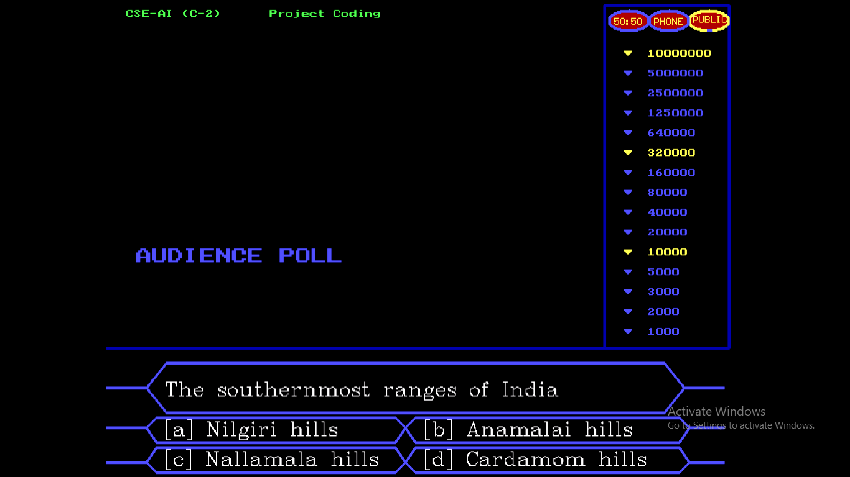

Slide 26
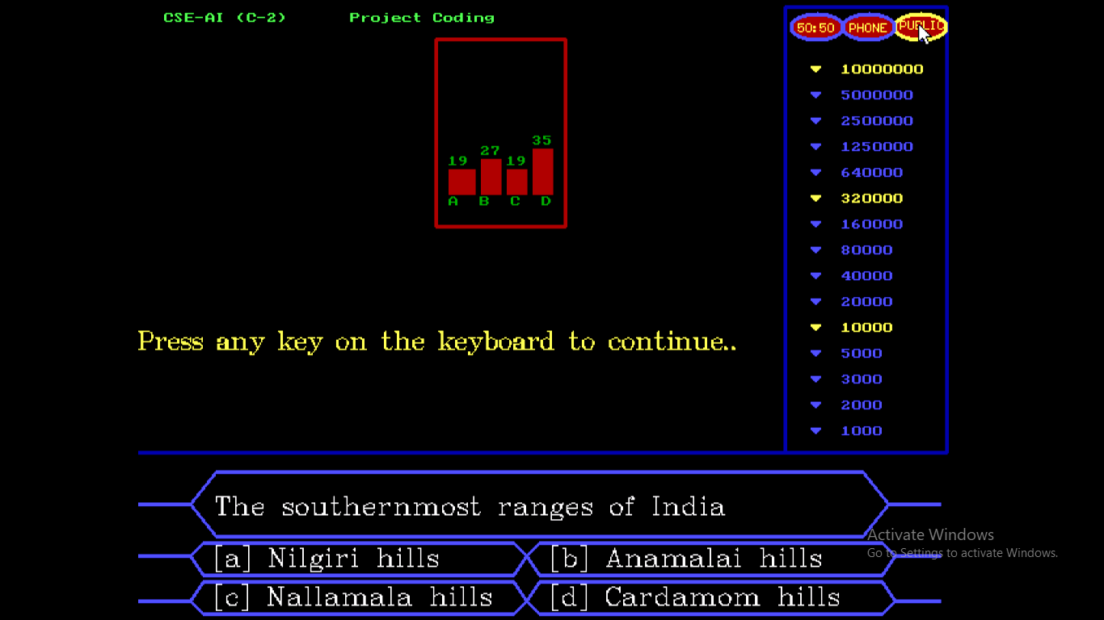

Slide 27
C) PHONE A FRIEND
It is one the three lifelines that gives the user a chance to find out the correct answer with the help of his/her friend or companion. In this lifeline the user is provided with 30 seconds so that the user could contact his/her companion to find out the correct answer, as soon as the time is over the user had to cut the communication between the user and companion and answer immediately.

Slide 28
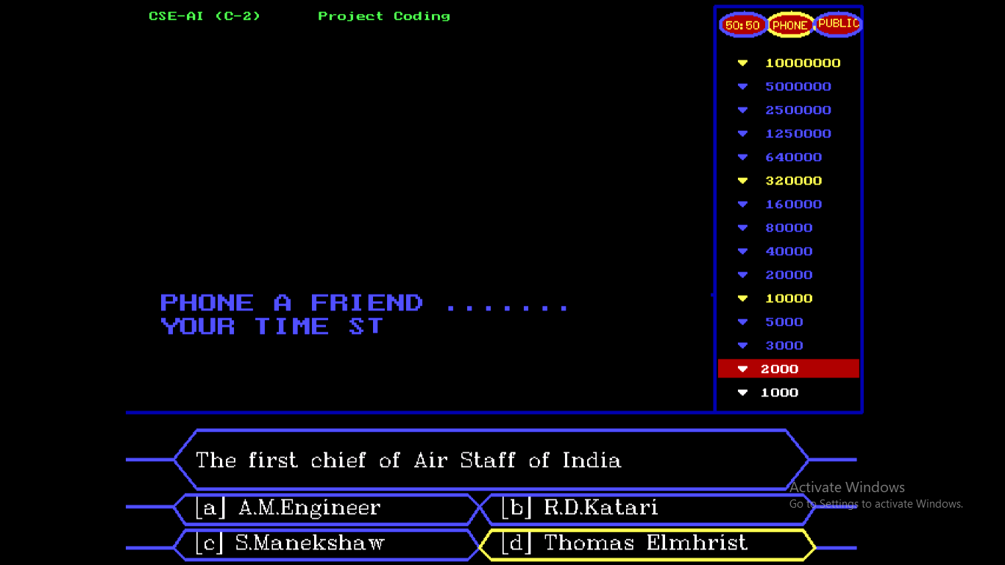

Slide 29
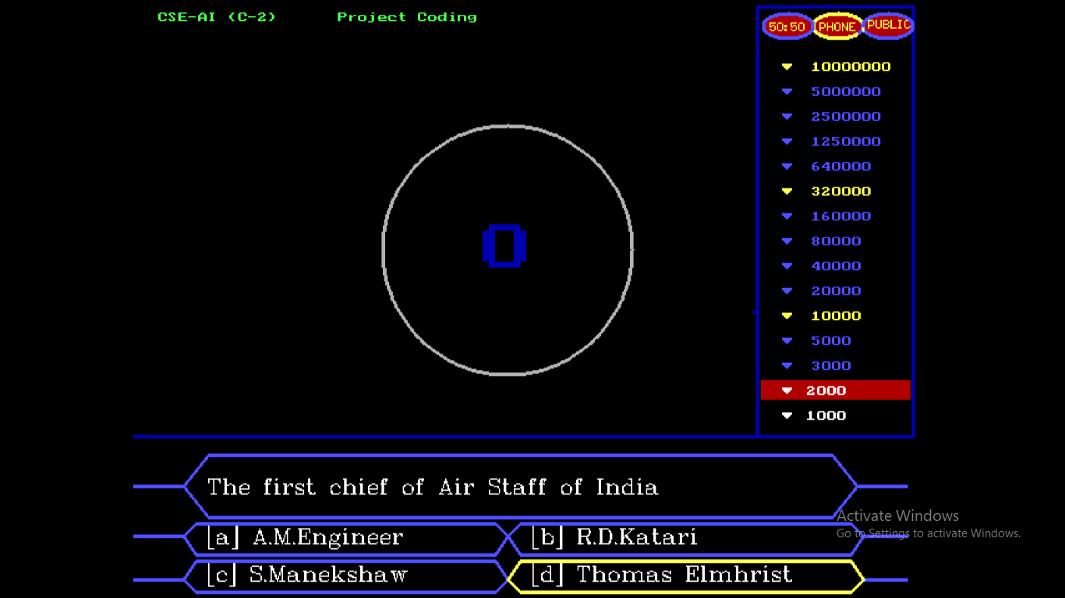

Slide 30
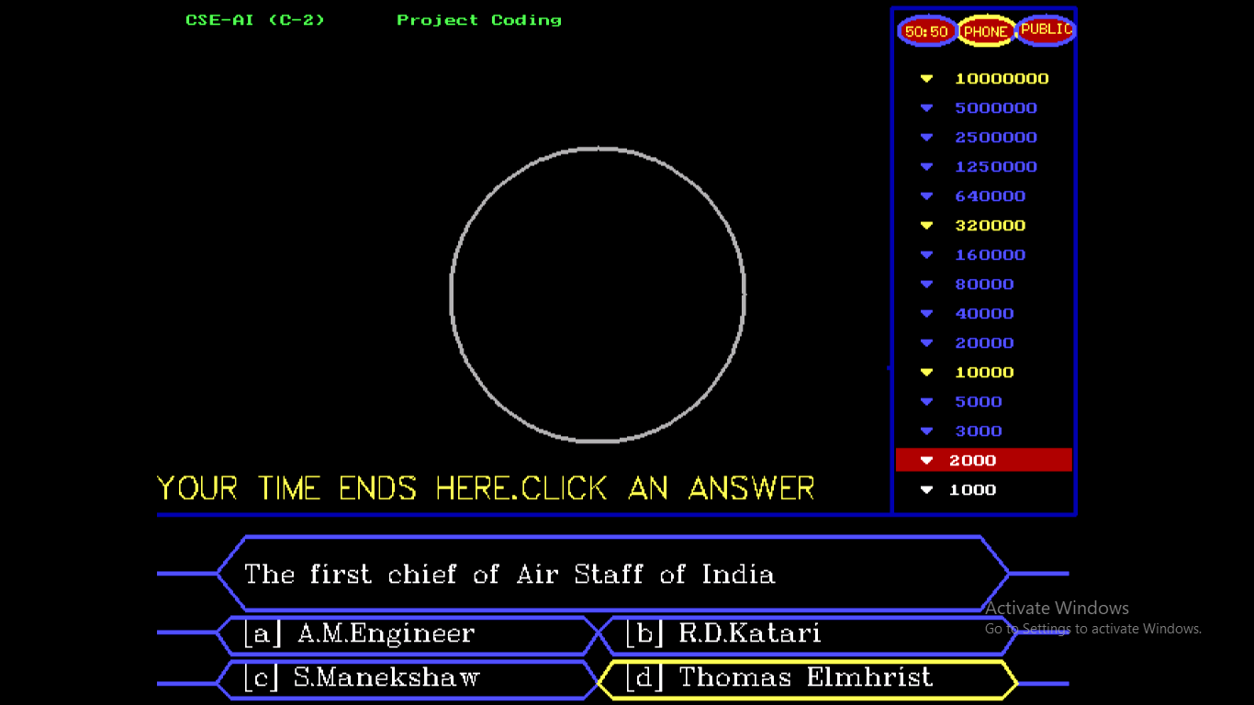

Slide 31
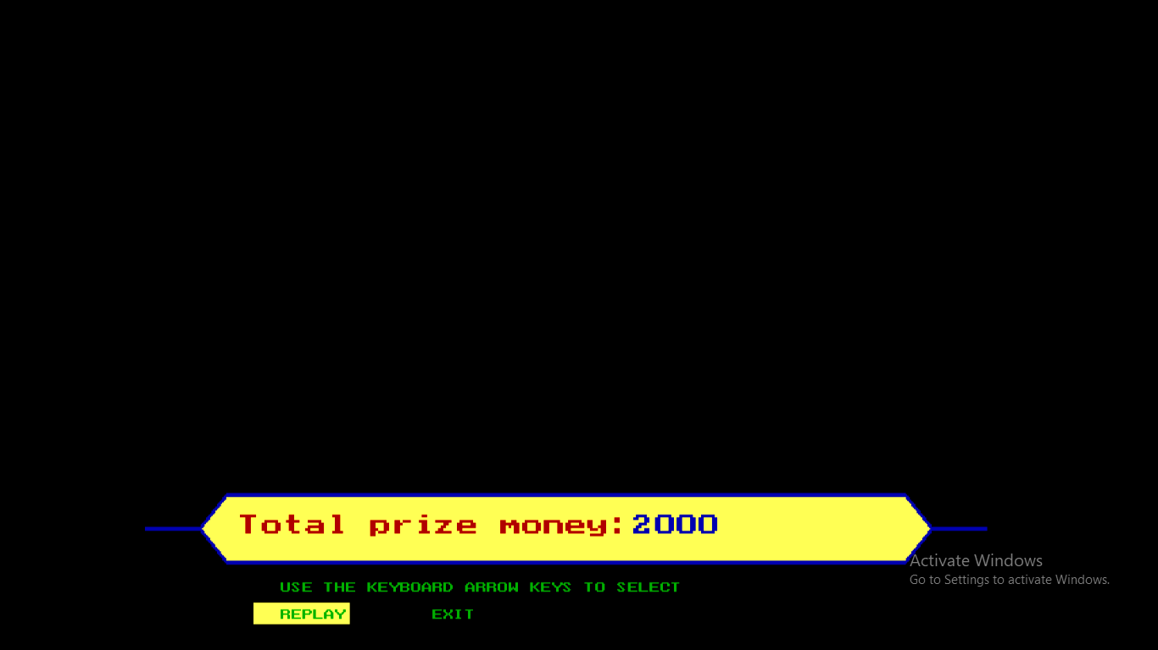

Slide 32
CONCLUSION
Our project is only a humble venture to satisfy the needs to manage their project work. several user friendly coding have also adopted. This package shall prove to be a powerful package in satisfying all the requirements of the school. The objective of software planning is to provide a frame work that enables the manger to make reasonable estimates made within a limited time frame at the beginning of the software project and should be updated regularly as the project progresses.

Slide 33
CONCLUDED POINTS
A description of the background and context of the project and its relation to work already done in the area.
Made statement of the aims and objectives of the project.
The description of Purpose, Scope, and applicability.
We describe the requirement Specifications of the system and the actions that can be done on these things.
We included features and operations in detail, including screen layouts.

Slide 34
FUTURE SCOPE OF THE PROJECT
In a nutshell, it can be summarized that the future scope of the project circles around maintaining information regarding:
We can give more advance software for KBC Quiz System including more facilities like including one more lifeline i.e. expert’s advice.
We will host the platform on online servers to make it accessible worldwide
Create the master and slave database structure to reduce the overload of the database queries
Implement the backup mechanism for taking backup of codebase and database on regular basis on different servers

Slide 35
The above mentioned points are the enhancements which can be done to increase the applicability and usage of this project. Here we can maintain the records of Questions and Answers.
We have left all the options open so that if there is any other future requirement in the system by the user for the enhancement of the system then it is possible to implement them. In the last we would like to thanks all the persons involved in the development of the system directly or indirectly. We hope that the project will serve its purpose for which it is develop there by underlining success of process.

